Slide 1
Predicting Stock Volatility Through Time-series Analysis
Brian Zamkotowicz
Spring 2019
Springboard Capstone Project

Slide 2
Why Volatility Matters
Provide smooth portfolio returns.
Create profitable trading strategies.
Limit exposure to potentially volatile markets.

Slide 3
The Process
Obtain the data and begin to think about analysis methodology.
Clean and organize the data in useable way.
Examine the data as a time-series.
Use the information to build a predictive model.
Use the model to make recommendations to the client base.

Slide 4
The Data
Availability of a wealth of historical stock market data on quandl.com
Focus on Microsoft a stock with a long history and (free) option information.
Write into quandl API.
Combine both data on the stock itself and data on stock options.
Normalize for stock splits.
Drop longer dated metrics and remove NaN’s by focussing on 2013 through 2017.

Slide 5
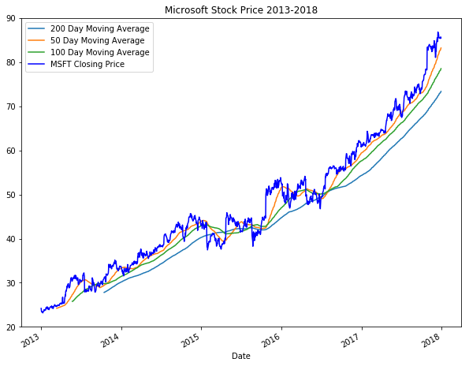
Microsoft Price 2013-2017
Notes:
Shows a chart of Microsoft Price for the period used. Note seasonal bumps as well as upward trend. This chart is adjusted for splits.

Slide 6
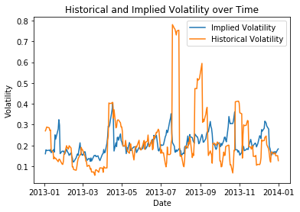
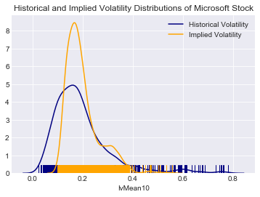
Implied vs Historical Volatility
Notes:
Left shows historical vs implied. Right side shows distribution. Each demonstarates instances of historical volatility outdistancing implied.

Slide 7
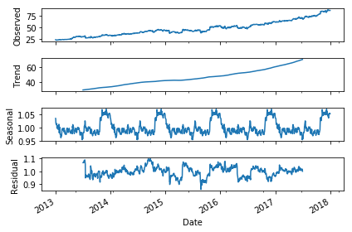
Decomposition of Season and Trend
Notes:
Top shows overall pattern. Second shows trend. Seasonal pattern 3rd. Final is what is left. This is a big advantage of time series.

Slide 8
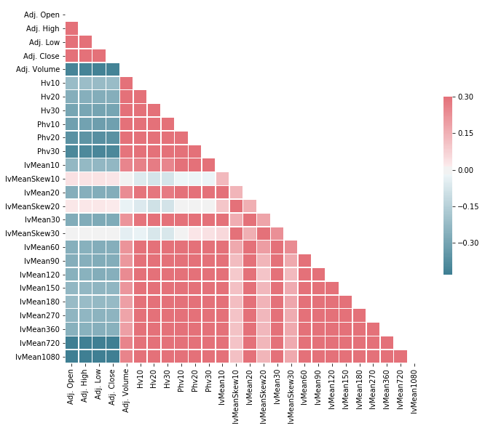
Heatmap of Feature Correlation
Notes:
Historical Volatility shows a reasonable correlation with implied volatility, and volume, but little correlation to skew and price

Slide 9
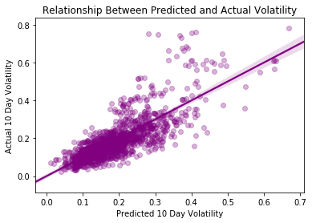
Regression Plot of Historical vs Predicted Volatility
Notes:
Again we can see a number of instances where historical volatility

Slide 10
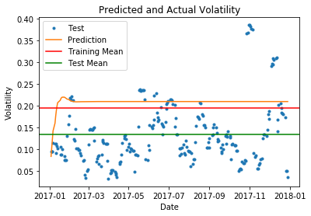
Baseline Model for Historical Volatility – ARIMA
The initial baseline model for testing forecast was done usig auto-ARIMA.
This method showed obvious fllaws.
After using recent data in the initial stages of the model, it reverts to an average volatility from the training period.

Slide 11
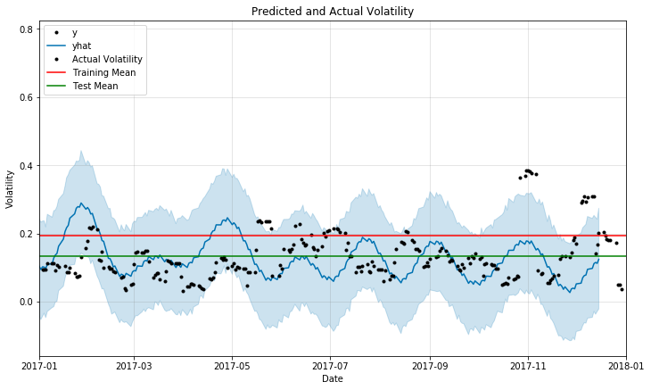
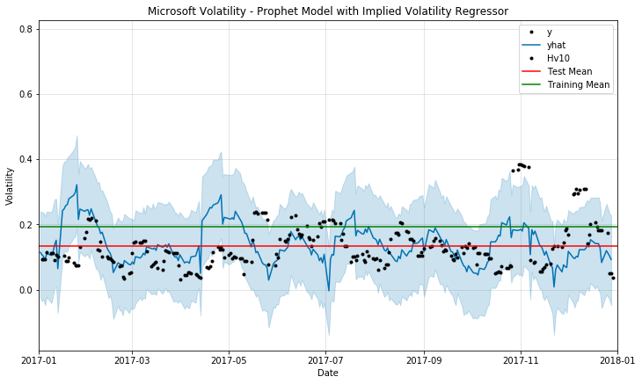
Comparison of Prophet Models
Prophet Model
Prophet with 10 Day Implied Volatility as Regressor

Slide 12
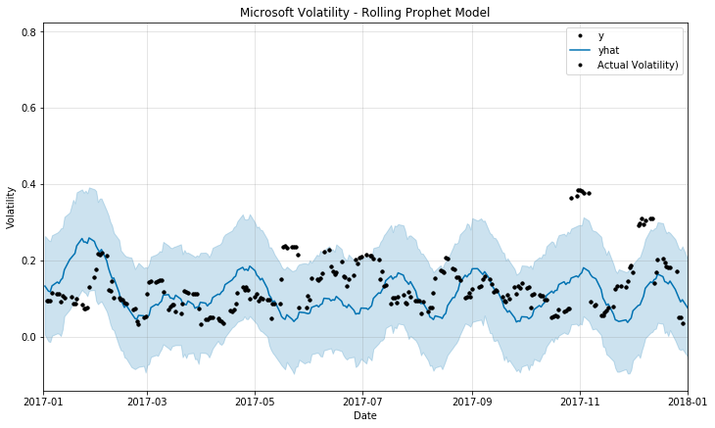
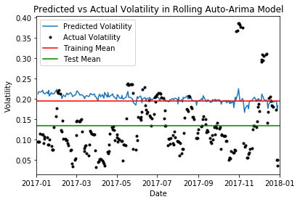
10-Day Rolling Models
Rolling Prophet
Rolling Auto-ARIMA

Slide 13
Model Performance
Model | RMSE | R-Squared | Lower Bound | Upper Bound
Auto_ARIMA | 0.103 | -1.143 | -0.16 | 0.084
Auto-ARIMA(Rolling 10-day) | 0.098 | -0.948 | -0.154 | 0.087
Prophet (Base) | 0.097 | -0.88 | -0.122 | 0.198
Prophet (Implied Volatility Regressor) | 0.091 | -0.688 | -0.147 | 0.183
Rolling Prophet | 0.087 | -0.501 | -0.083 | 0.191
Auto-ARIMA (Rolling 1-day) | 0.038 | 0.718 | -0.053 | 0.028

Slide 14
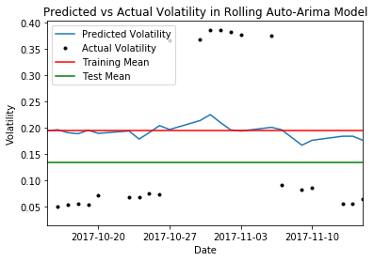
Predicting Direction of Volatility
Notes:
While the model doesn’t pick up the scale of moves it does manage to accurately predict the direction of those moves which may be useful

Slide 15
Future Work
Regressors – Using additional regressors in the Prophet model could help to tune a more effective model.
Short Term Traininhg - Using a 40 day training set would be a more appropriate period to train for a 10 day prediction.
Shorter Prediction Window - Using a shorter window than 10 days would be easier to predict and equally useful.

Slide 16
Recommendations for Client
The current model was unable to predict with greater accuracy than the mean of the test set.
Progress was made toward a more successful model and could be continued going forward.
Since the model was able to guage the direction of moves in volatility (but not their scale) it may still be useful in its current form.

Slide 17

Thank you
https://github.com/Zonk3/Capstone-2---Springboard
https://www.linkedin.com/in/brianzamkotowicz/

